Slide 1
Discrete Mathematics BCSC0010
Module 1
Relations (Lecture 8)

Slide 2
Properties of Relations
Reflexive Relation
Irreflexive Relation
Symmetric Relation
Transitive Relation

Slide 3
Transitive Relation
A relation R on a set A is called transitive if whenever (a, b) ∈ R and (b, c) ∈ R, then (a, c) ∈ R, for all a, b, c ∈ A.
The relation R on a set A is transitive if we have
∀a∀b∀c((a, b) ∈ R and (b, c) ∈ R) → (a, c) ∈ R).

Slide 4
Example
R = {(2, 1), (3,1), (3, 2), (4,1), (4, 2), (4, 3)}
R is transitive

Slide 5
Summary
Let R is a relation on set X. It is
Reflexive
if (a,a)∈R, for each a∈X.
Symmetric
if (a,b)∈R implies (b,a)∈R.
Transitive
if (a,b)∈R and (b,c)∈R implies (a,c)∈R.
Irreflexive
if (a,a)∉R, for each a∈X.

Slide 6
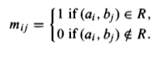
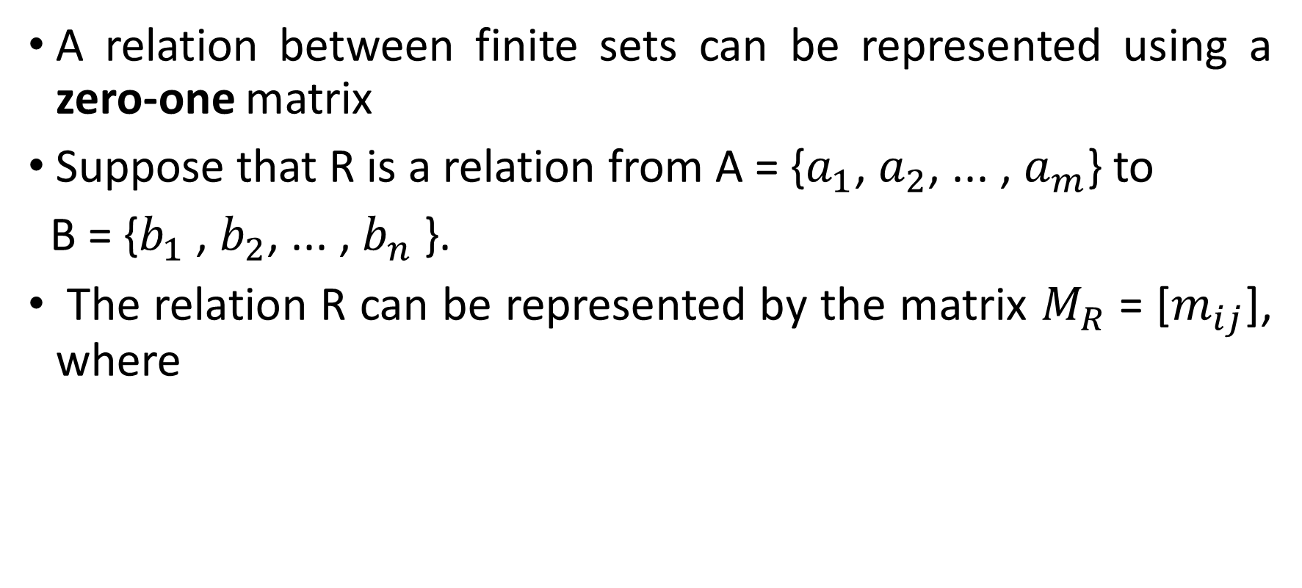
Representing Relations Using Matrices
A relation between finite sets can be represented using a zero-one matrix
Suppose that R is a relation from A = {$a_{1}$, $a_{2}$, ... , $a_{m}$} to
B = {$b_{1}$ , $b_{2}$, ... , $b_{n}$ }.
The relation R can be represented by the matrix $M_{R}$ = [$m_{ij}$], where

Slide 7

Example

Slide 8
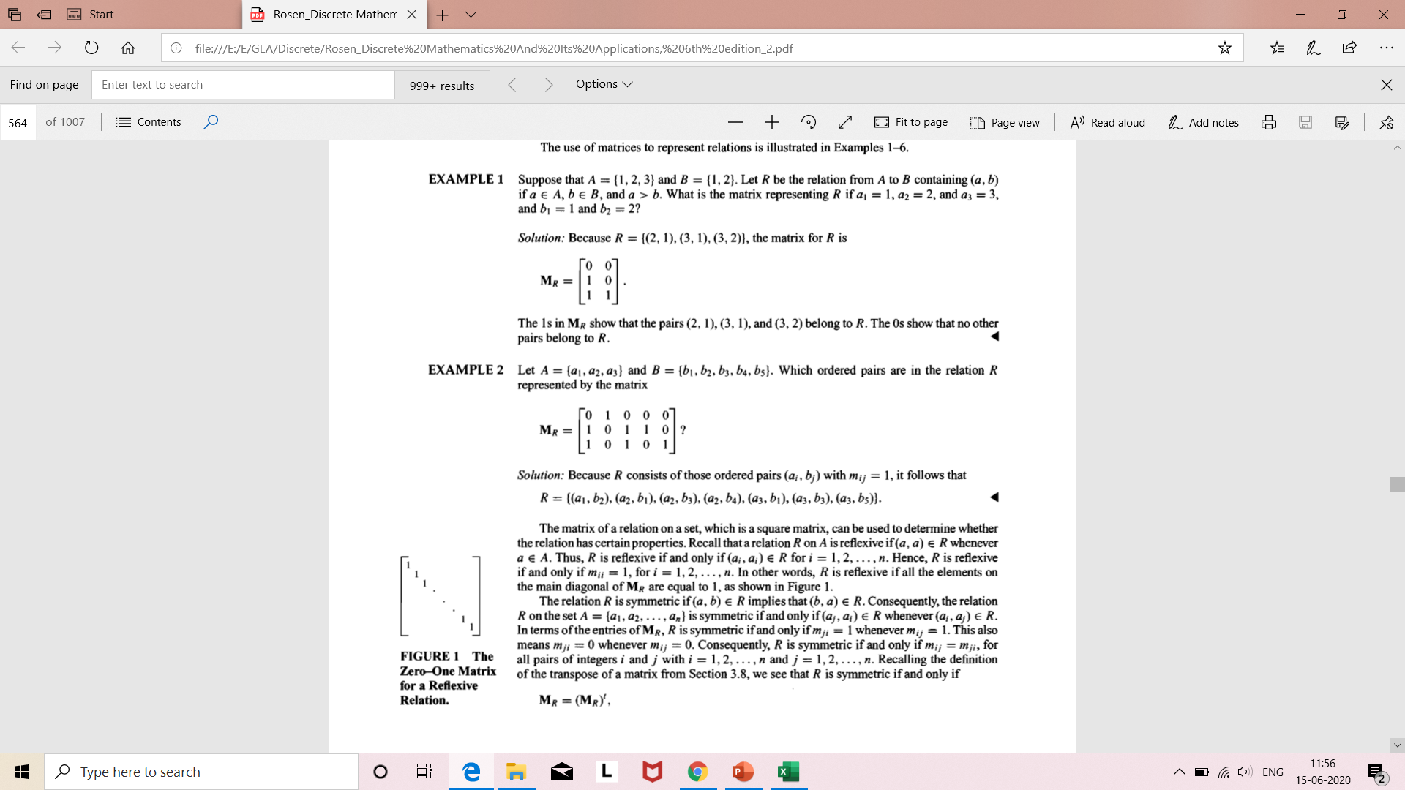
Example

Slide 9
Equivalence Relation
A relation on a set A is called an equivalence relation if it is reflexive, symmetric, and transitive.
Example
The relation “is equal to”, denoted “=”, is an equivalence relation on the set of real numbers since for any x, y, z ∈ R:
1. (Reflexivity) x = x,
2. (Symmetry) if x = y then y = x,
3. (Transitivity) if x = y and y = z then x = z.
All of these are true.

Slide 10
Example
R be a relation on set of integers Z defined by
R = {(x, y) | x-y is divisible by 3}. Show that R is an equivalence relation.
Solution
Consider any a,b,c∈Z
Since a−a=0=3.0⇒(a−a) is divisible by 3.
⇒(a,a)∈R
⇒ is reflexive.
Contd…

Slide 11
Let (a,b)∈R⇒ (a−b) is divisible by 3.
⇒a−b=3q
⇒a−b=3q for some q∈Z
⇒b−a=3(−q)
⇒(b−a)is divisible by 3 (∵q∈Z⇒−q∈Z⇒−q∈Z)
Thus, (a,b)∈R⇒(b,a)∈R⇒R is symmetric.

Slide 12
.
Let (a,b)∈R and (b,c)∈R
⇒(a−b)is divisible by 3 and (b−c) is divisible by 3
⇒a−b=3q and b−c=3q′ for some q,q′∈Z
⇒(a−b)+(b−c)=3(q+q′)
⇒a−c=3(q+q′)
⇒(a−c) is divisible by 3 (∵q.q′ ∈Z⇒q+q′ ∈Z)
⇒(a,c)∈R
Thus, (a,b)∈R and (b,c)∈R⇒ (a,c)∈R ⇒ R is transitive.
Therefore, the relation R is reflexive, symmetric and transitive, and hence it is an equivalence relation

Slide 13
Next Topic..
Recurrence Relations

